Slide 1
Parallel and Distributed Computing
Graph Algorithms

Slide 2
Definitions and Representation
An undirected graph G is a pair (V, E), where V is a finite set of points called vertices and E is a finite set of edges.
An edge e ∈ E is an unordered pair (u, v), where u, v ∈ V .
In a directed graph, the edge e is an ordered pair (u, v). An edge (u, v) is incident from vertex u and is incident to vertex v.
A path from a vertex v to a vertex u is a sequence hv0, v₁, v₂, . . . , v_{k} of vertices where v0 = v, v_{k} = u, and (vi, vi+1) ∈ E for i = 0, 1, . . . , k − 1.
The length of a path is defined as the number of edges in the path.

Slide 3
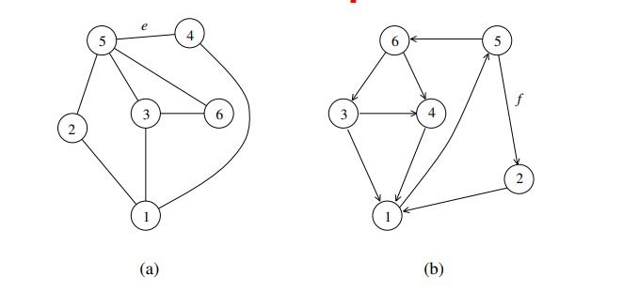
Definitions and Representation
(a) An undirected graph and (b) a directed graph

Slide 4
Definitions and Representation
An undirected graph is connected if every pair of vertices is connected by a path.
A forest is an acyclic graph, and a tree is a connected acyclic graph.
A graph that has weights associated with each edge is called a weighted graph.

Slide 5
Definitions and Representation
Graphs can be represented by their adjacency matrix or an edge (or vertex) list.
Adjacency matrices have a value a_{i,j} = 1 if nodes i and j share an edge; 0 otherwise. In case of a weighted graph, a_{i,j} = w_{i,j}, the weight of the edge.
The adjacency list representation of a graph G = (V, E) consists of an array Adj[1..|V |] of lists. Each list Adj[v] is a list of all vertices adjacent to v.
For a graph with n nodes, adjacency matrices take θ(n²) space and adjacency list takes Θ(|E|) space

Slide 6
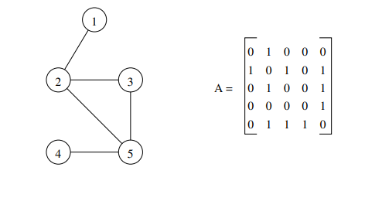
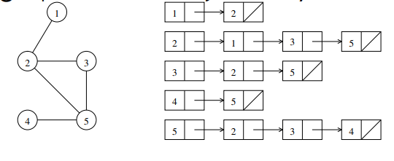


Definitions and Representation
An undirected graph and its adjacency matrix representation.
An undirected graph and its adjacency list representation.

Slide 7
Minimum Spanning Tree
A spanning tree of an undirected graph G is a subgraph of G that is a tree containing all the vertices of G.
In a weighted graph, the weight of a subgraph is the sum of the weights of the edges in the subgraph.
A minimum spanning tree (MST) for a weighted undirected graph is a spanning tree with minimum weight

Slide 8
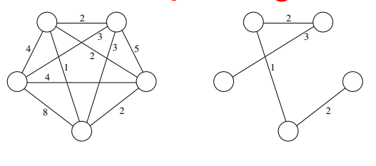

Minimum Spanning Tree
An undirected graph and its minimum spanning tree.

Slide 9
Minimum Spanning Tree: Prim’s Algorithm
Prim’s algorithm for finding an MST is a greedy algorithm.
Start by selecting an arbitrary vertex, include it into the current MST.
Grow the current MST by inserting into it the vertex closest to one of the vertices already in current MST

Slide 10
Minimum Spanning Tree: Prim’s Algorithm
Prim’s algorithm for finding an MST is a greedy algorithm.
• Start by selecting an arbitrary vertex, include it into the current MST.
Grow the current MST by inserting into it the vertex closest to one of the vertices already in current MST.

Slide 11
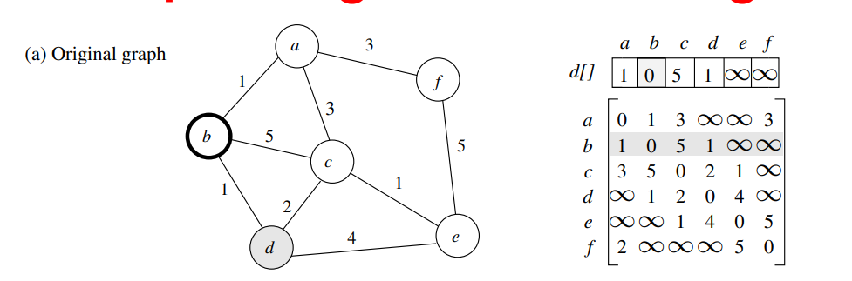
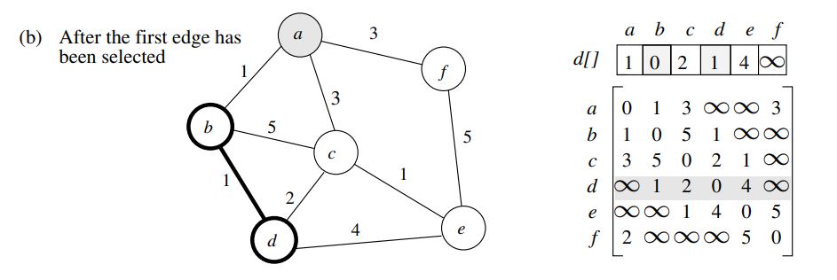

Minimum Spanning Tree: Prim’s Algorithm

Slide 12
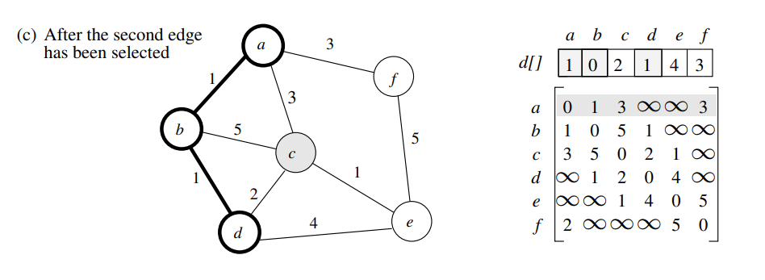
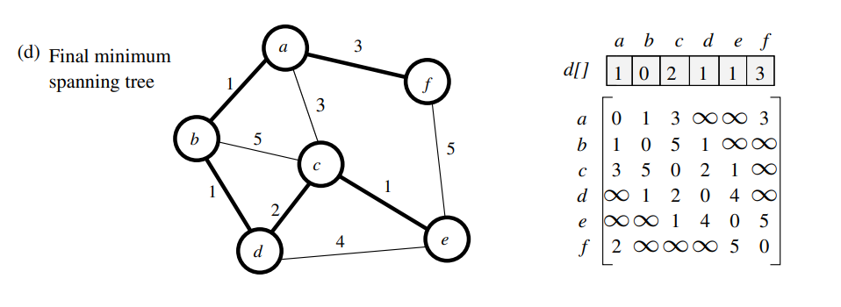

Minimum Spanning Tree: Prim’s Algorithm

Slide 13
Minimum Spanning Tree: Prim’s Algorithm
1. procedure PRIM MST(V, E, w, r)
2. begin
3. VT := {r};
4. d[r] := 0;
5. for all v ∈ (V − VT ) do
6. if edge (r, v) exists set d[v] := w(r, v);
7. else set d[v] := ∞;
8. while VT 6= V do
9. begin
10. find a vertex u such that d[u] := min{d[v]|v ∈ (V − VT )};
11. VT := VT ∪ {u};
12. for all v ∈ (V − VT ) do
13. d[v] := min{d[v], w(u, v)};
14. endwhile
15. end PRIM MST
Prim’s sequential minimum spanning tree algorithm

Slide 14
Prim’s Algorithm: Parallel Formulation
The algorithm works in n outer iterations – it is hard to execute these iterations concurrently.
The inner loop is relatively easy to parallelize. Let p be the number of processes, and let n be the number of vertices.
The adjacency matrix is partitioned in a 1-D block fashion, with distance vector d partitioned accordingly.
In each step, a processor selects the locally closest node. followed by a global reduction to select globally closest node.
This node is inserted into MST, and the choice broadcast to all processors.
Each processor updates its part of the d vector locally

Slide 15
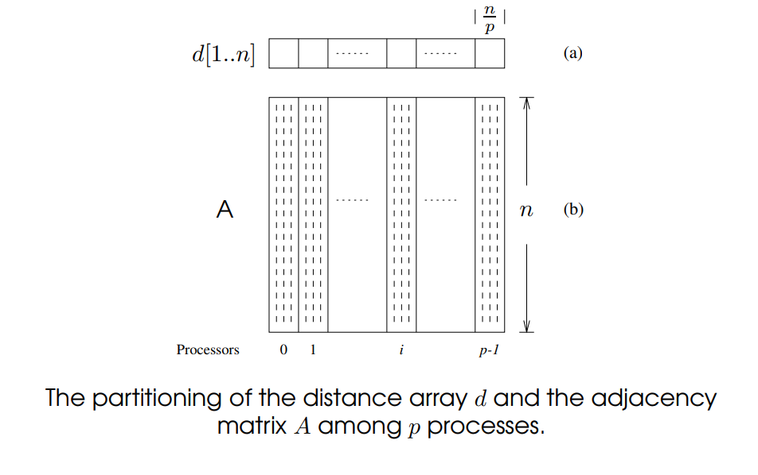
Prim’s Algorithm: Parallel Formulation

Slide 16
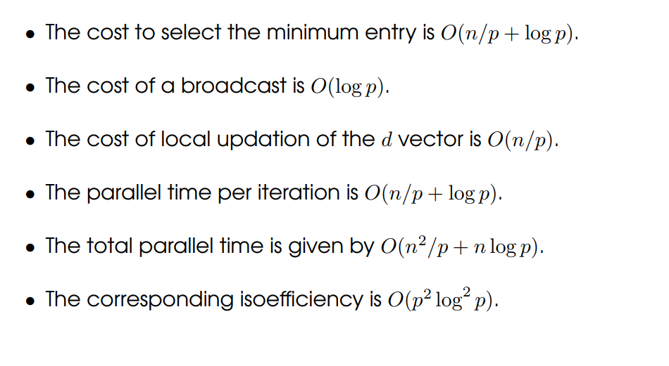
Prim’s Algorithm: Parallel Formulation

Slide 17
Single-Source Shortest Paths
For a weighted graph G = (V, E, w), the single-source shortest paths problem is to find the shortest paths from a vertex v ∈ V to all other vertices in V .
Dijkstra’s algorithm is similar to Prim’s algorithm. It maintains a set of nodes for which the shortest paths are known.
It grows this set based on the node closest to source using one of the nodes in the current shortest path set.

Slide 18
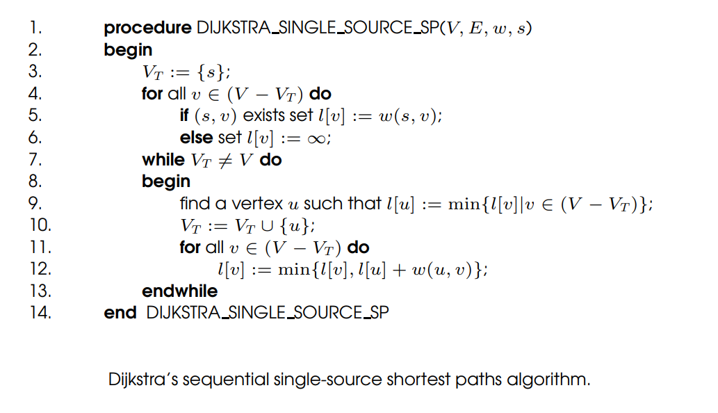
Single-Source Shortest Paths: Dijkstra’s Algorithm

Slide 19
Dijkstra’s Algorithm: Parallel Formulation
Very similar to the parallel formulation of Prim’s algorithm for minimum spanning trees.
The weighted adjacency matrix is partitioned using the 1-D block mapping.
Each process selects, locally, the node closest to the source, followed by a global reduction to select next node.
The node is broadcast to all processors and the l-vector updated.
The parallel performance of Dijkstra’s algorithm is identical to that of Prim’s algorithm.

Slide 20
All-Pairs Shortest Paths
Given a weighted graph G(V, E, w), the all-pairs shortest paths problem is to find the shortest paths between all pairs of vertices vi, vj ∈ V .
A number of algorithms are known for solving this problem.

Slide 21
All-Pairs Shortest Paths: Matrix-Multiplication Based Algorithm
Consider the multiplication of the weighted adjacency matrix with itself – except, in this case, we replace the multiplication operation in matrix multiplication by addition, and the addition operation by minimization.
Notice that the product of weighted adjacency matrix with itself returns a matrix that contains shortest paths of length 2 between any pair of nodes.
It follows from this argument that A^{n} contains all shortest paths.

Slide 22
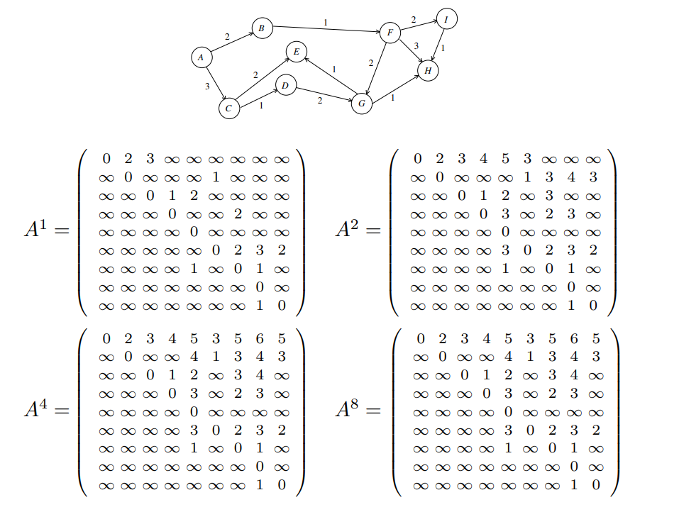
Matrix-Multiplication Based Algorithm

Slide 23
Matrix-Multiplication Based Algorithm
A^{n} is computed by doubling powers – i.e., as A, A², A⁴, A⁸, and so on.
We need log n matrix multiplications, each taking time O(n³).
The serial complexity of this procedure is O(n³ log n).
This algorithm is not optimal, since the best-known algorithms have complexity O(n3).

Slide 24
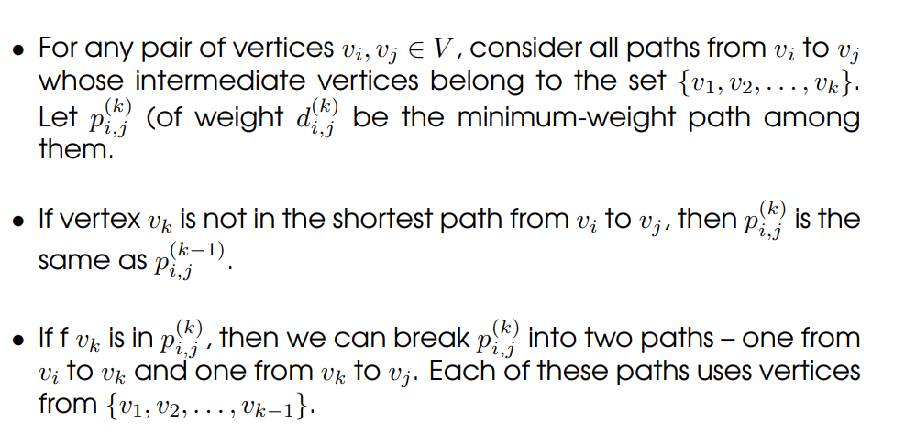
Floyd’s Algorithm

Slide 25
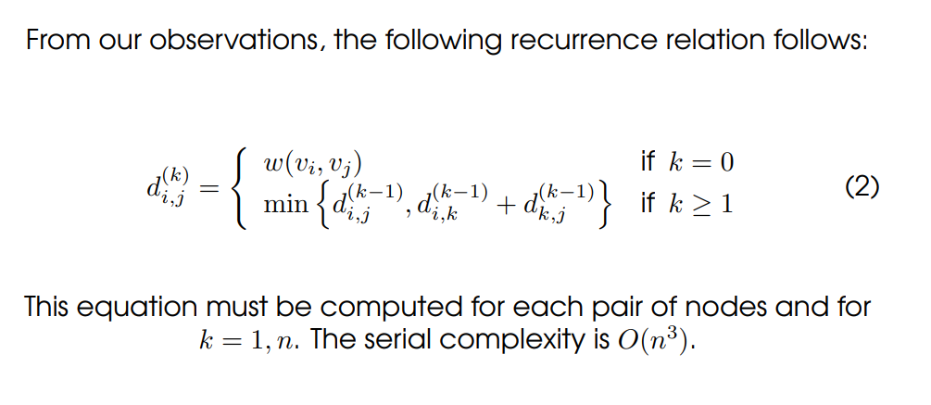
Floyd’s Algorithm

Slide 26
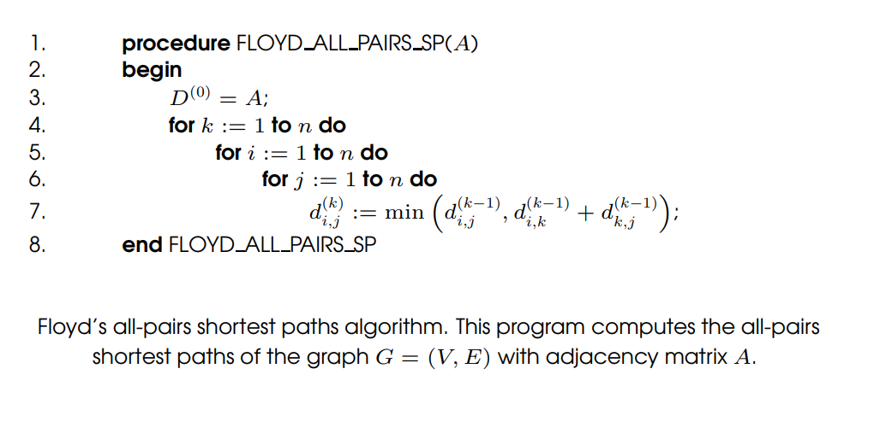
Floyd’s Algorithm

Slide 27
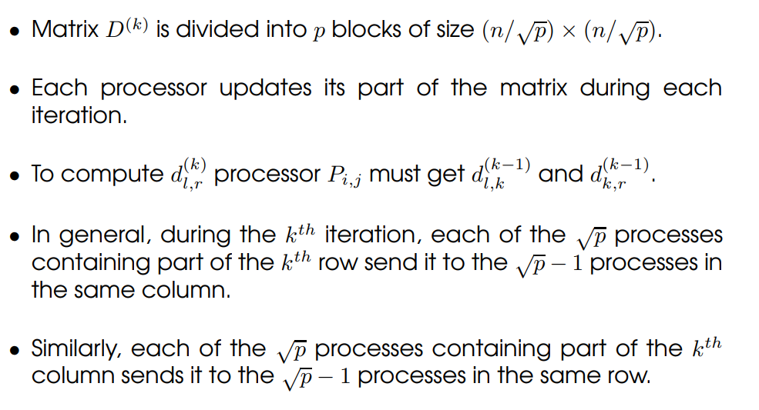
Floyd’s Algorithm: Parallel Formulation Using 2-D Block Mapping

Slide 28
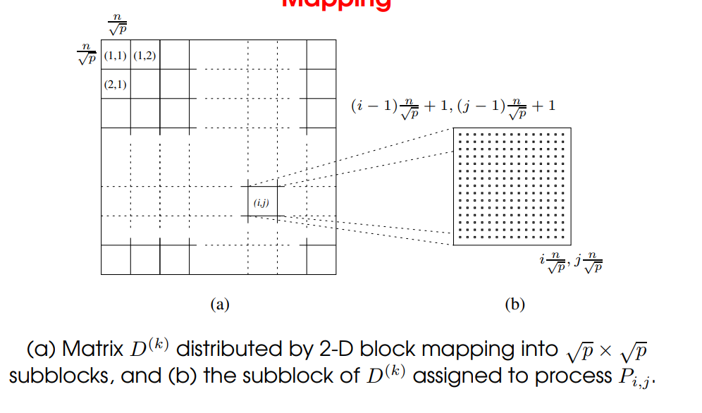

Floyd’s Algorithm: Parallel Formulation Using 2-D Block Mapping

Slide 29
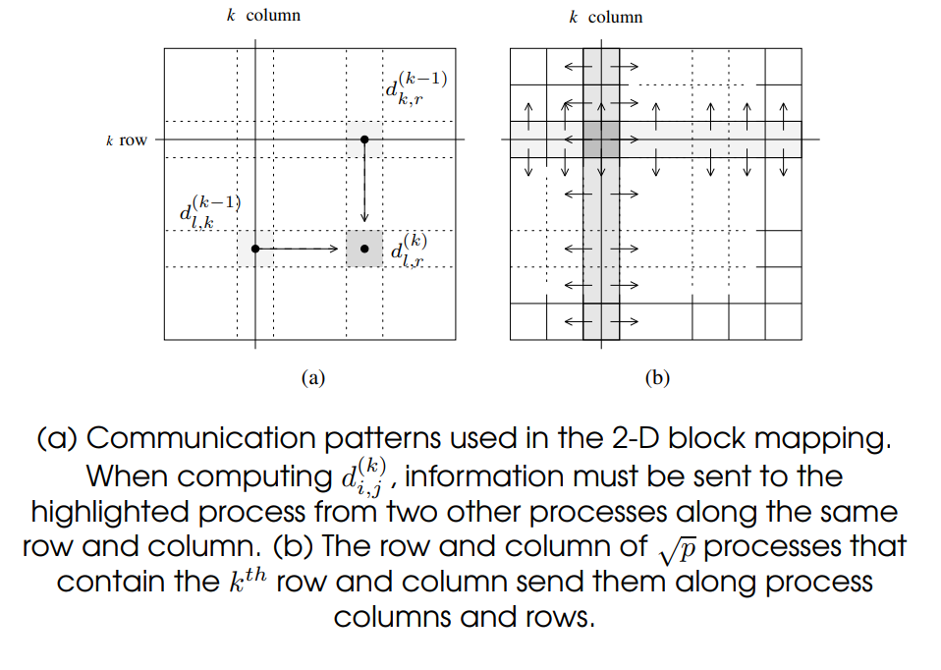

Floyd’s Algorithm: Parallel Formulation Using 2-D Block Mapping

Slide 30
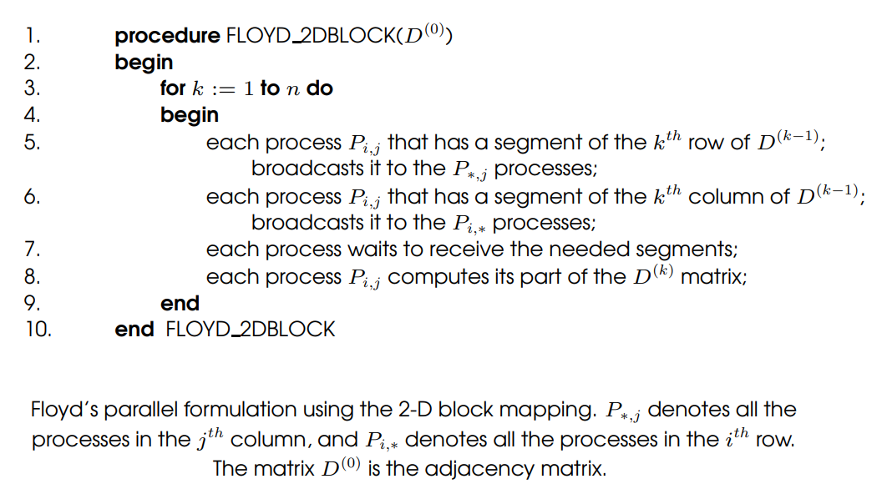
Floyd’s Algorithm: Parallel Formulation Using 2-D Block Mapping

Slide 31
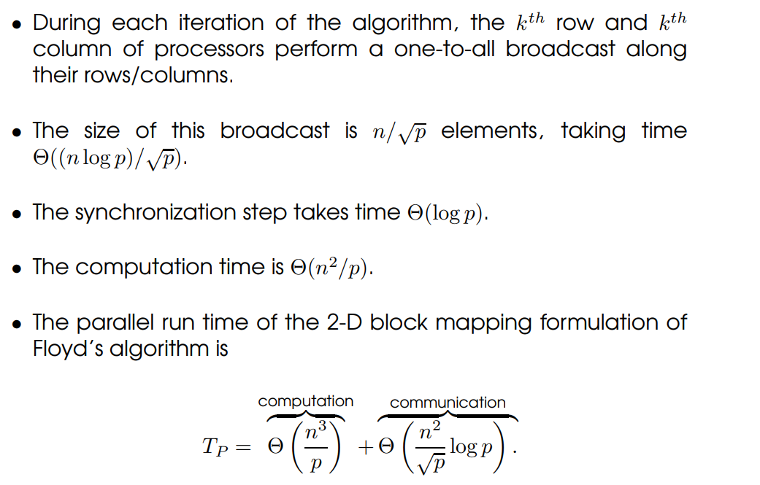
Floyd’s Algorithm: Parallel Formulation Using 2-D Block Mapping

